Slide 1
EDA Mini Project
Group 2
Chiu Wing Fung, Aaron
Wong Shing Fung, Dov

Slide 2
Objective
To find the relationship between different elements:
Number or players
Play Times
Complexity
Rating
Mechanics
Others…
How can I to make a good/ best seller board game easier by adjusting various elements?

Slide 3
Data Description

Slide 4
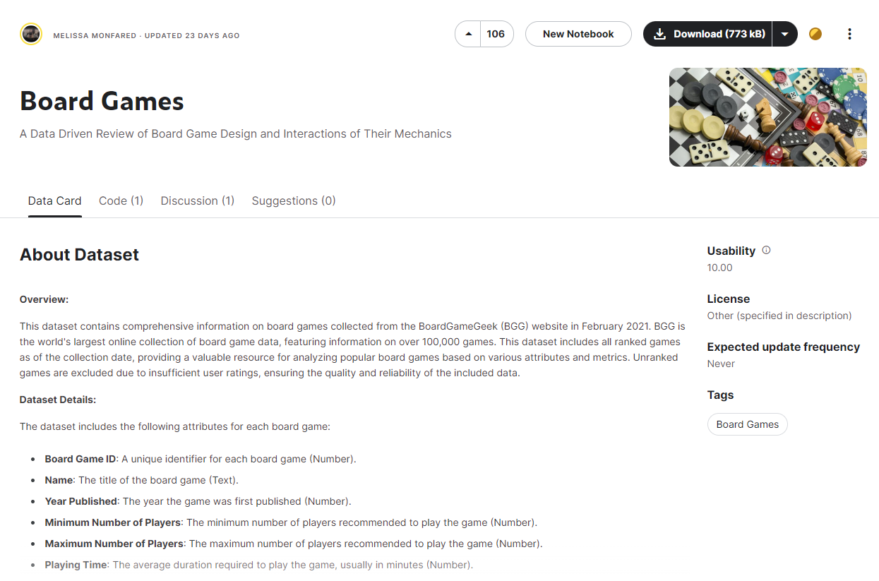
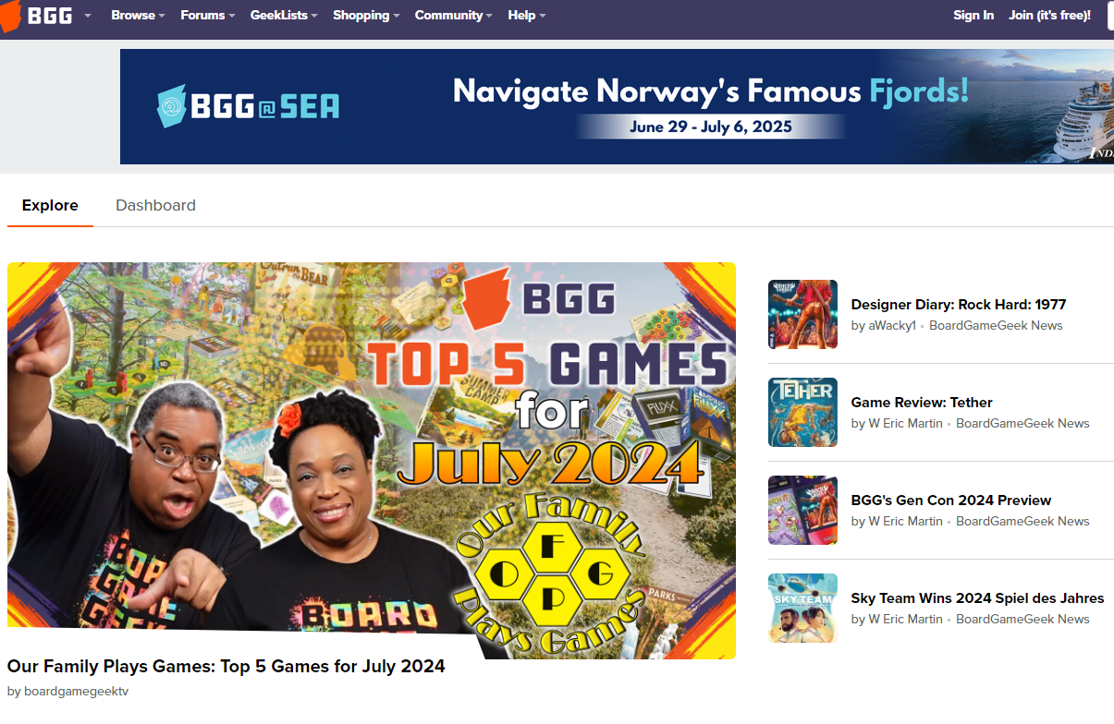
Dataset soruce
https://www.kaggle.com/datasets/melissamonfared/board-games

Slide 5
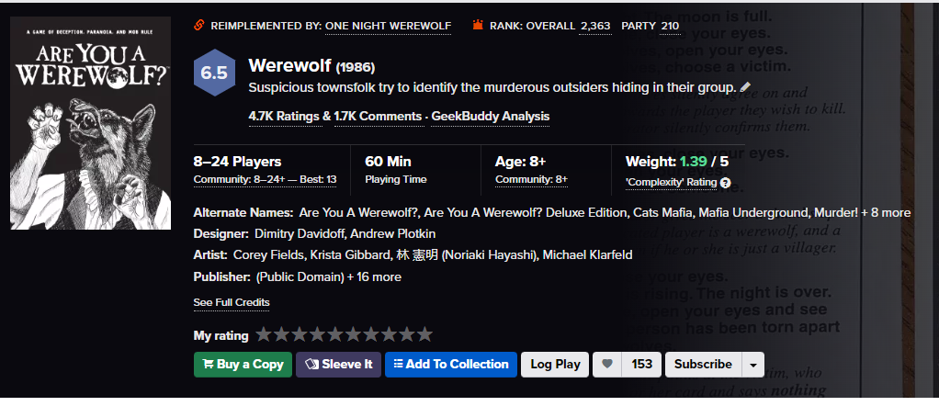
BGG

Slide 6
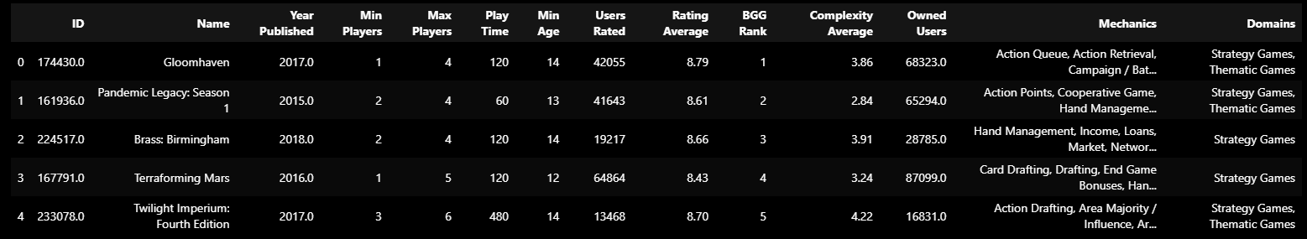
Dataset

Slide 7
Data Cleansing

Slide 8
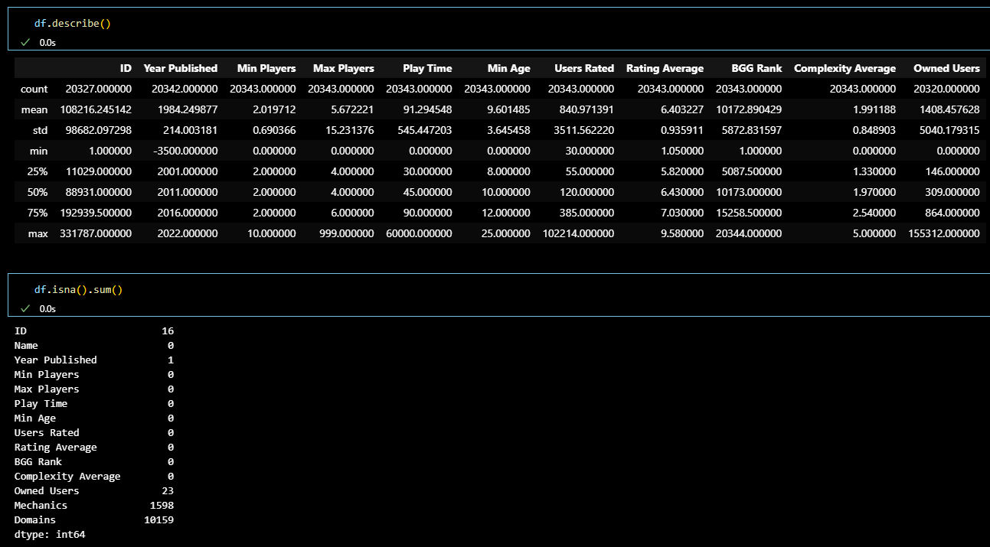
Data Cleansing
Missing values
Zero values
(Missing)

Slide 9
Data Cleansing
Column | Action
Year Published | Drop the row with no value (only 1 datum, not big effect on the data)
Min Players | The min of Min Players is 0, which means missing data. This data is important for prediction. If not too much missing data, we will drop those row. If too much, we will consider other approach.
Max Players | Same as "Min Players"
Play Time | Same as "Min Players"
Min Age | This column seems irrelevant because average age of players will be better. Also, people tend to ignore it. So we will drop the whole column.
Complexity Average | There are 23 missing data. Need to check 0 values also, same as "Min Player"
Mechanics | Same as "Min Player"
Domains | Drop the whole column as there are too many missing values

Slide 10
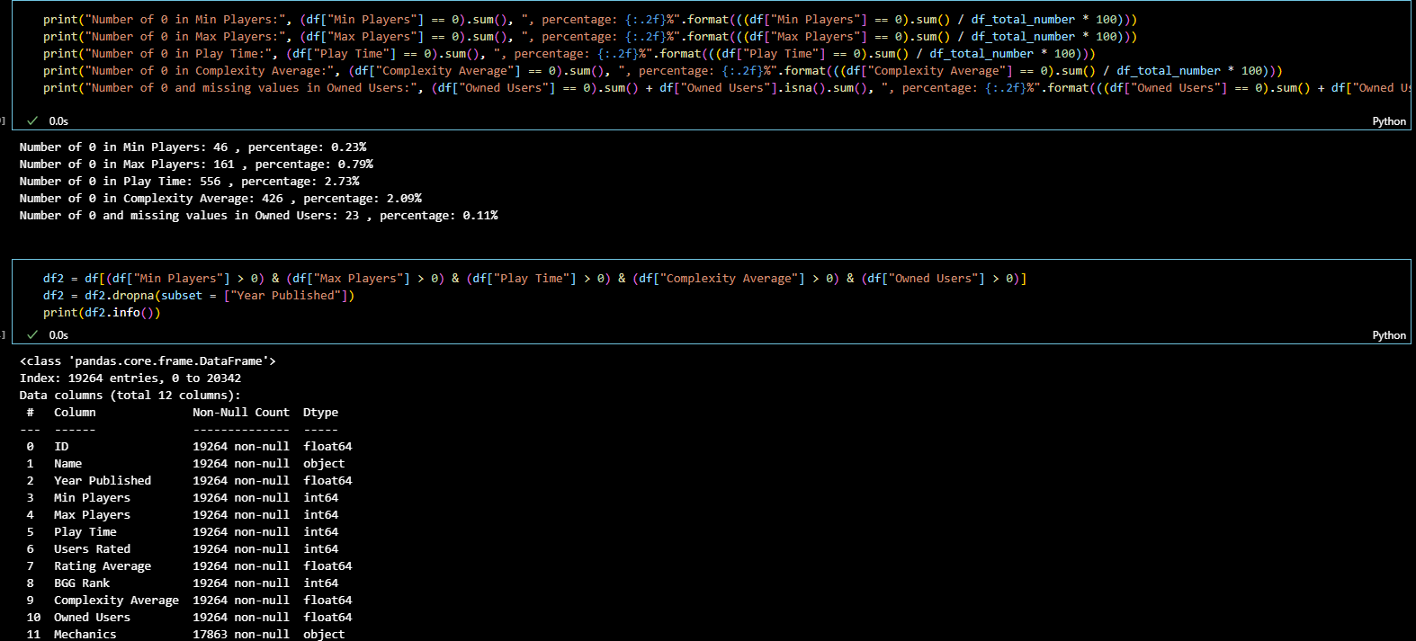
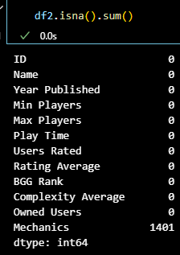
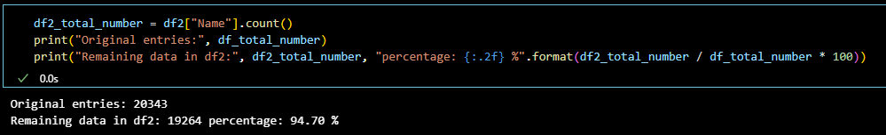
After Cleansing

Slide 11
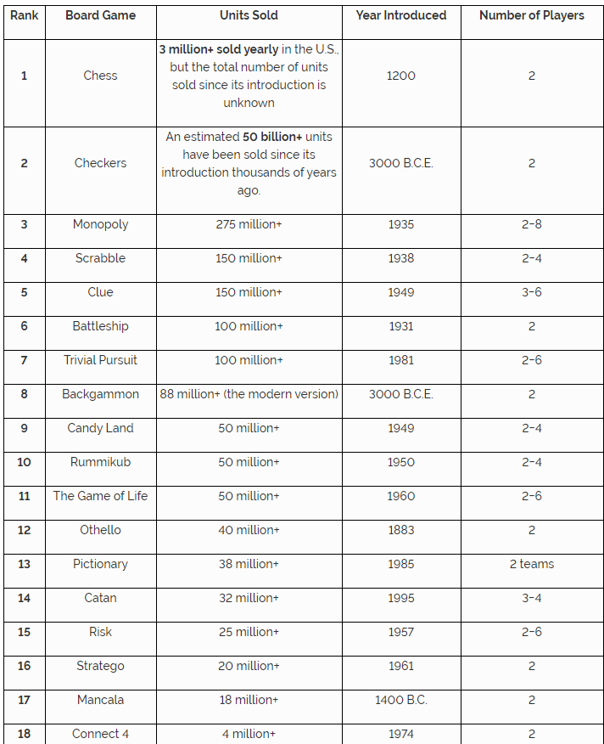
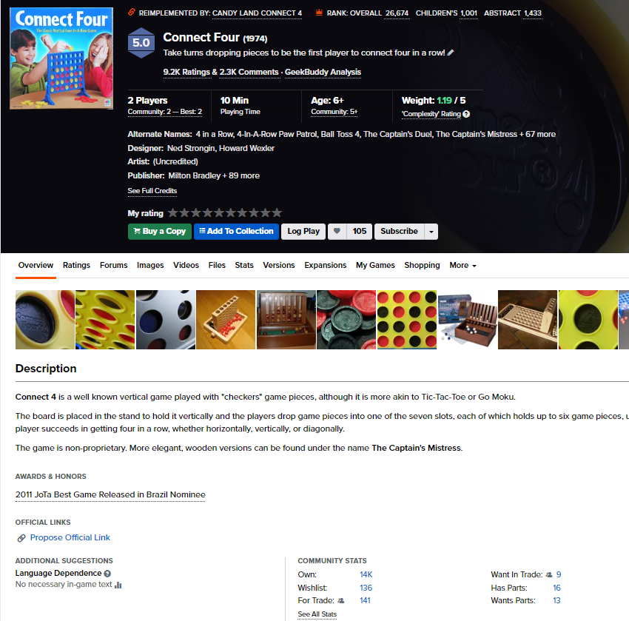
Inaccurate Data

Slide 12
Univariate Analysis

Slide 13
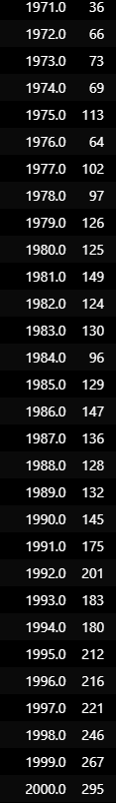
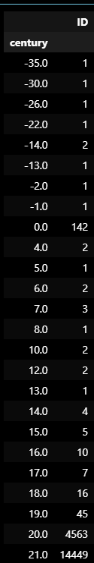
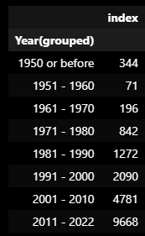
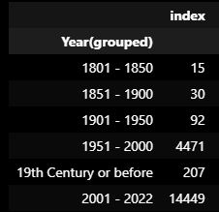
Year Published

Slide 14
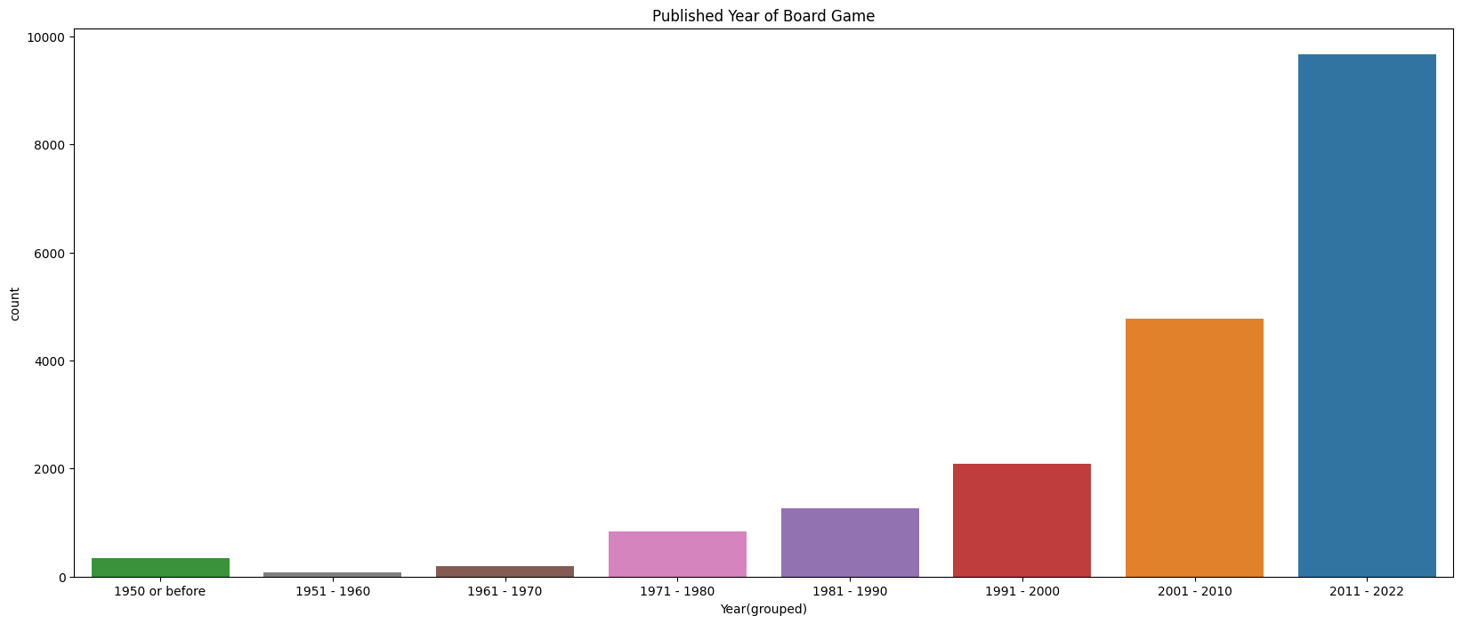
Year Published
More and more board games are released after 2000

Slide 15
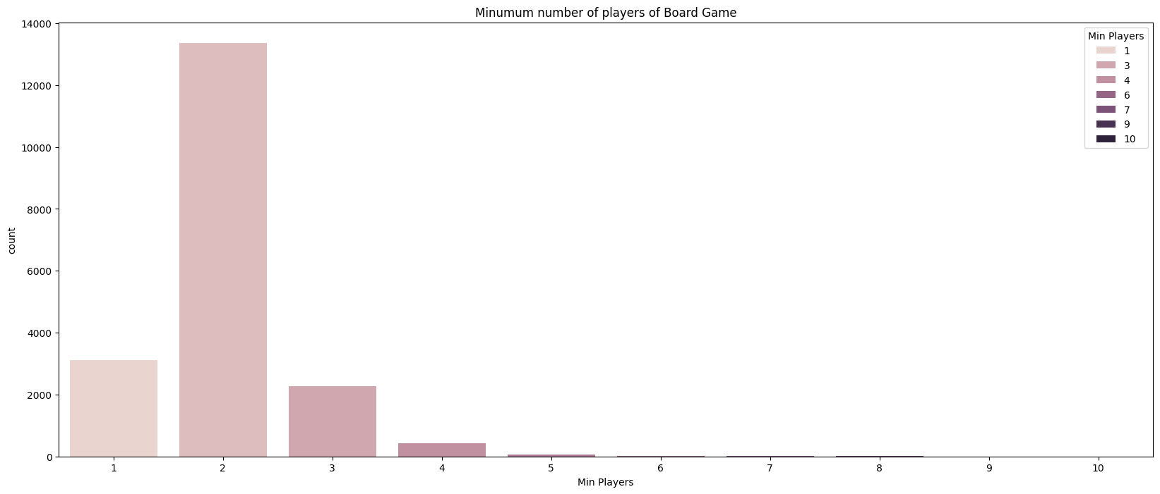
Min Players

Slide 16
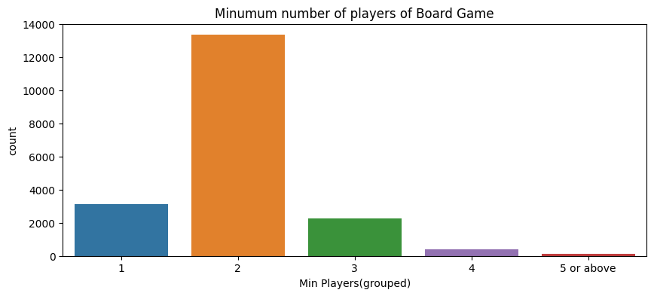
Min Players
Almost min players of all board game is between 1 to 3 players
About 70% of min players is 2 players

Slide 17
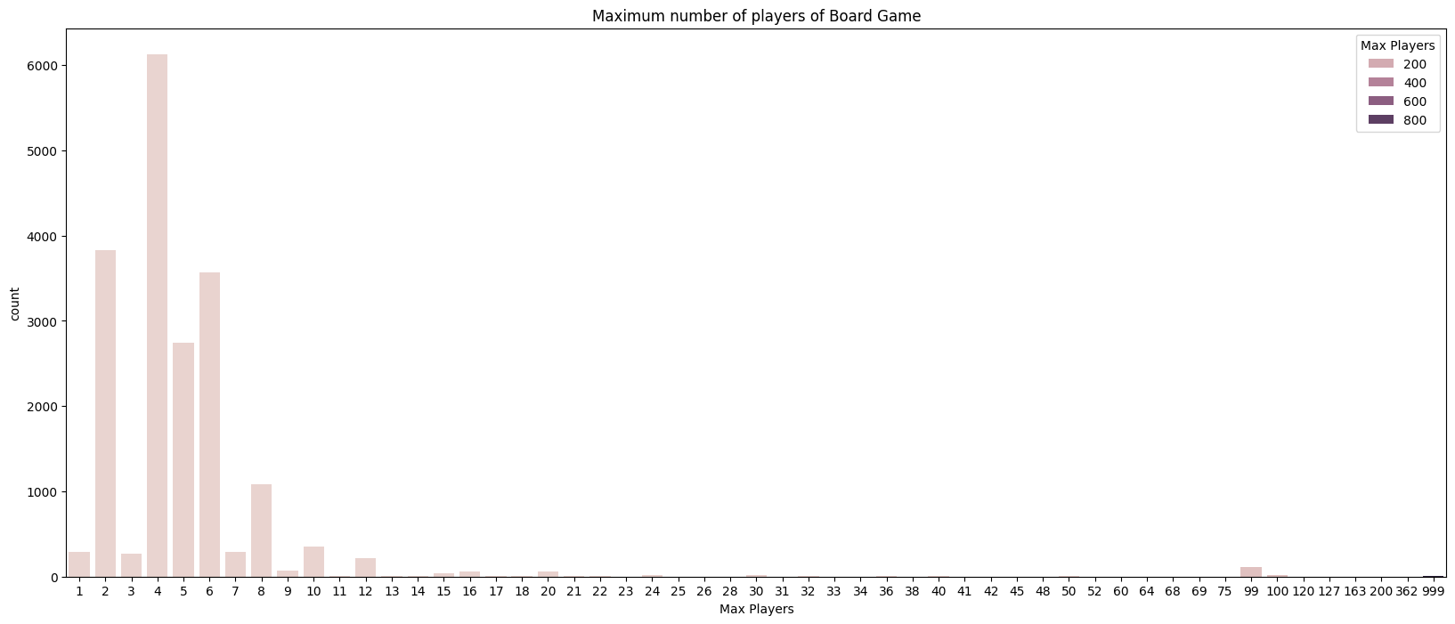
Max Players

Slide 18
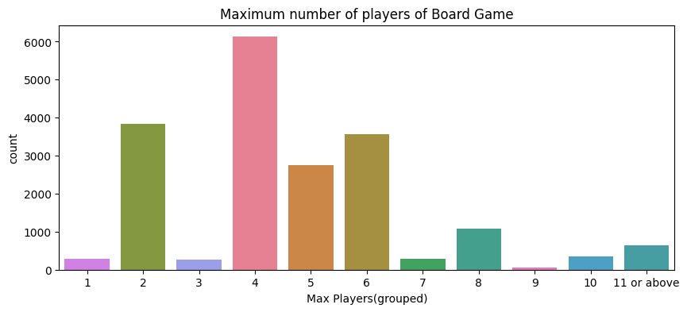
Max Players
Most of max players are between 4 - 6 players

Slide 19
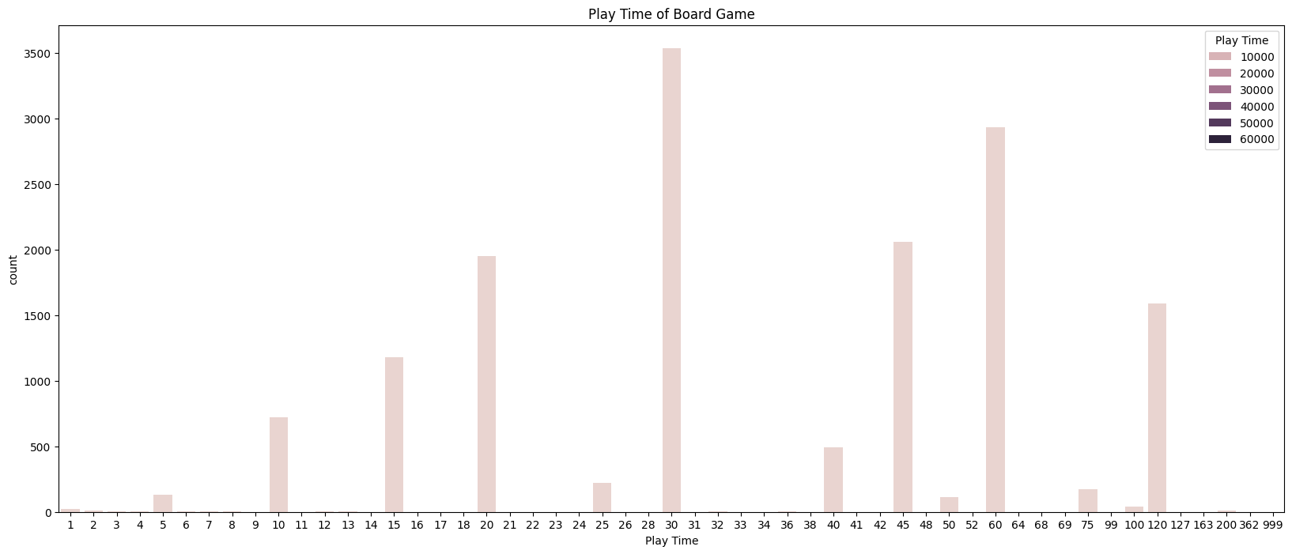
Play Time

Slide 20
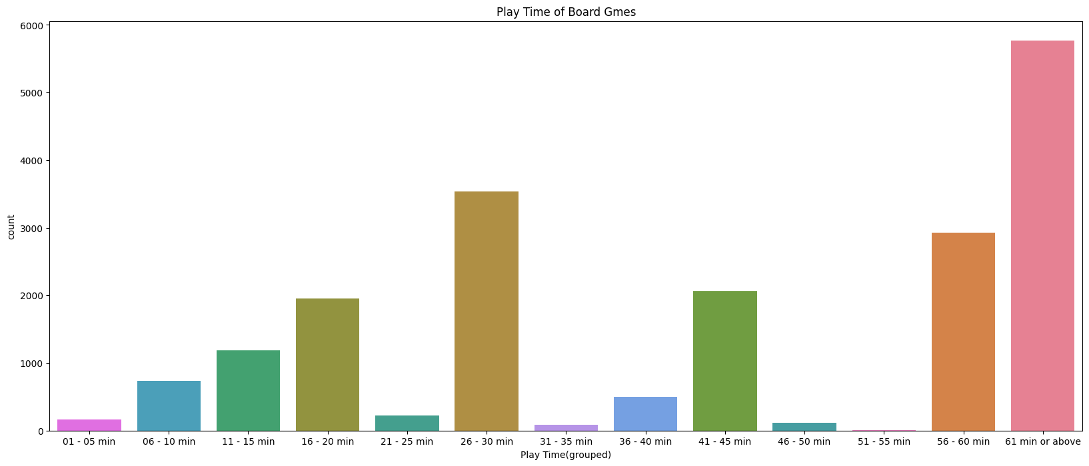
Play Time
Most of play time are more than 56 mins

Slide 21
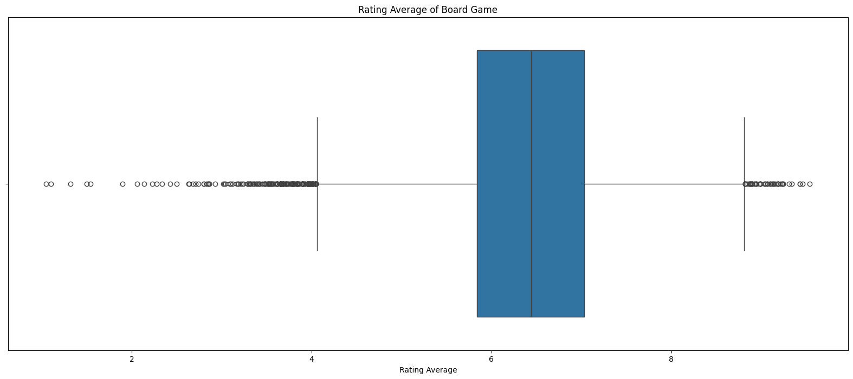
Rating Average
Min value (excluding
outliers): 4.05
Max value (excluding
outliers): 8.82
As we want to make a high
rating game, so those
outliners, especially those
higher than max, are valuable

Slide 22
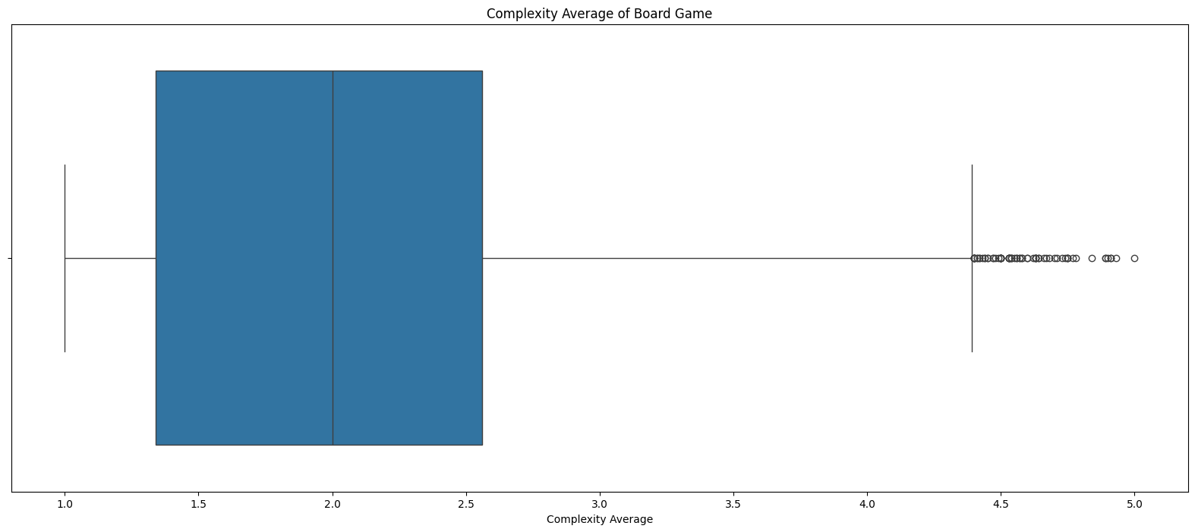
Complexity Average
Min value (excluding
outliers): 1
Max value (excluding
outliers): 4.39
No. of outliers: 70 (0.36%)
We decide to keep them:
Minority
Within the range (1 - 5)

Slide 23
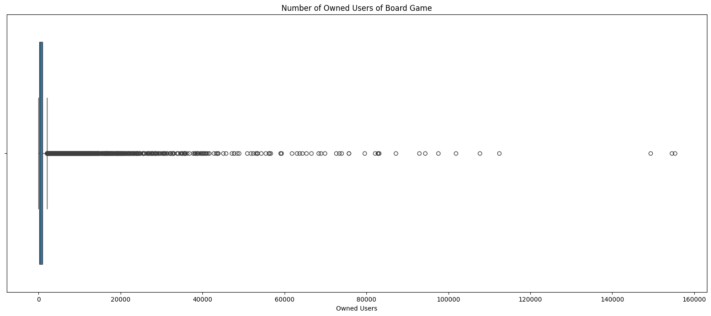
Owned Users (For reference only)

Slide 24
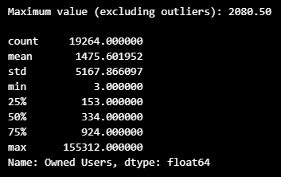
Owned Users (For reference only)

Slide 25
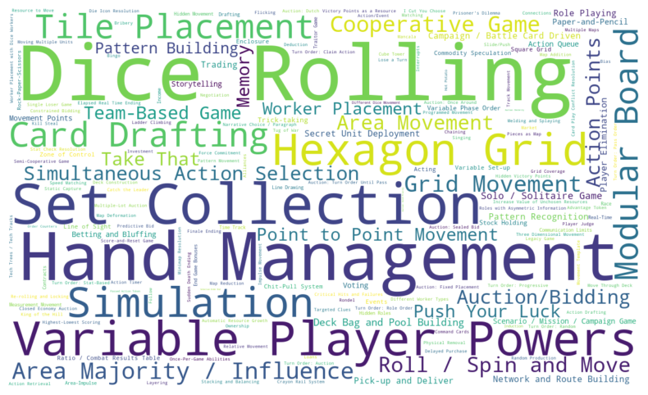
Mechanics (For reference only)

Slide 26
Bivariate Analysis

Slide 27
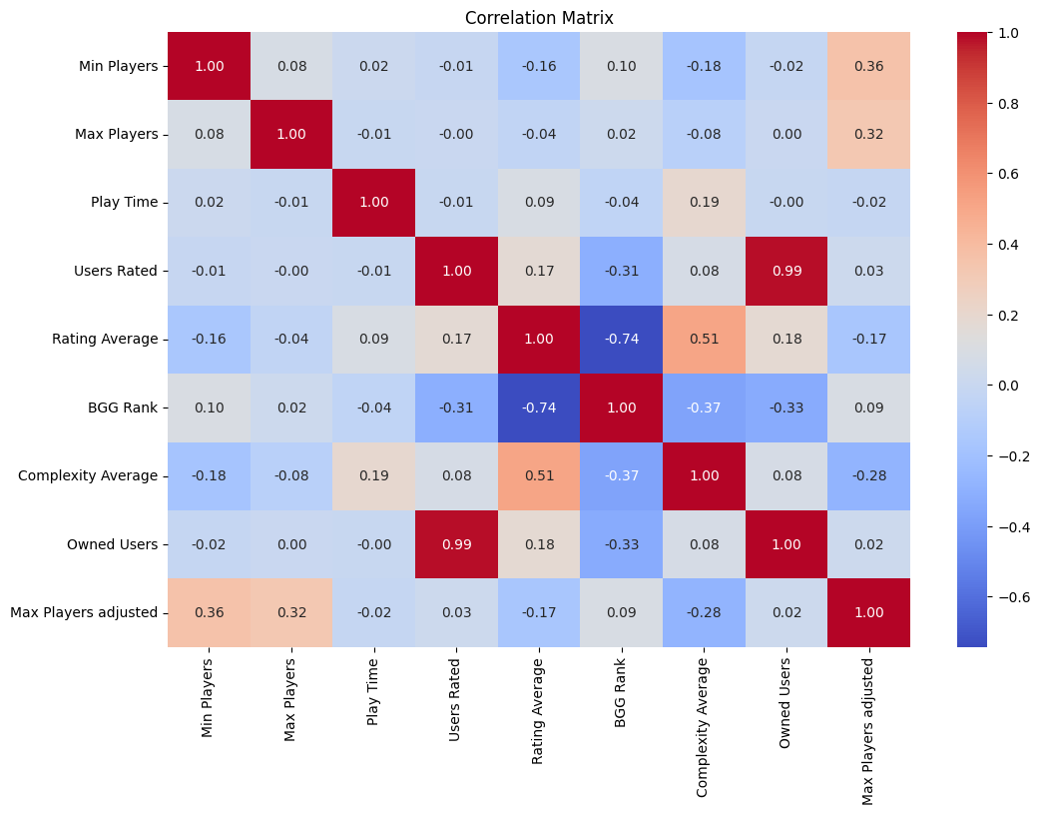
Heatmap

Slide 28
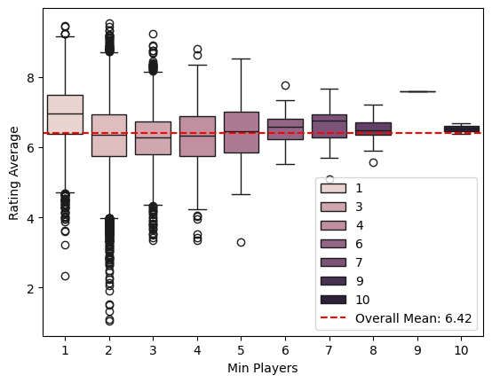
Min Players & Rating Average
Rating for board game with min
player of 1 is relatively higher

Slide 29
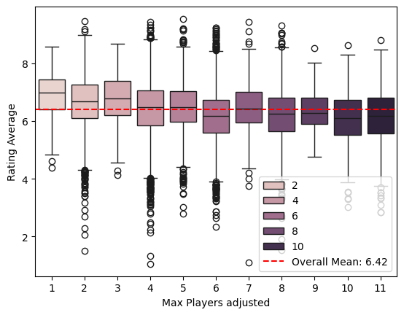
Max Players & Rating Average
Rating for board game with lesser
max player are relatively higher
Correlation with rating: -0.17
Correlation with complexity: -0.28
Correlation of complexity with
rating: 0.51
Guessing:
More players -> party game -> simpler
Game with higher max players -> design for larger group -> hard to meet

Slide 30
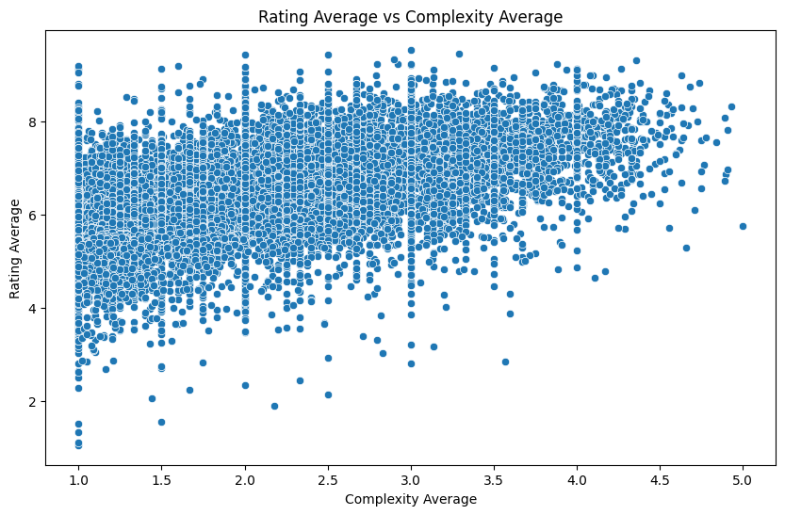
Rating Average vs Complexity Average

Slide 31

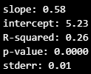
Rating Average vs Complexity Average
Higher complexity,
higher rating
Correlation of
complexity with
rating: 0.51
Rating Average =
5.23 + 0.58 x Complexity Average

Slide 32
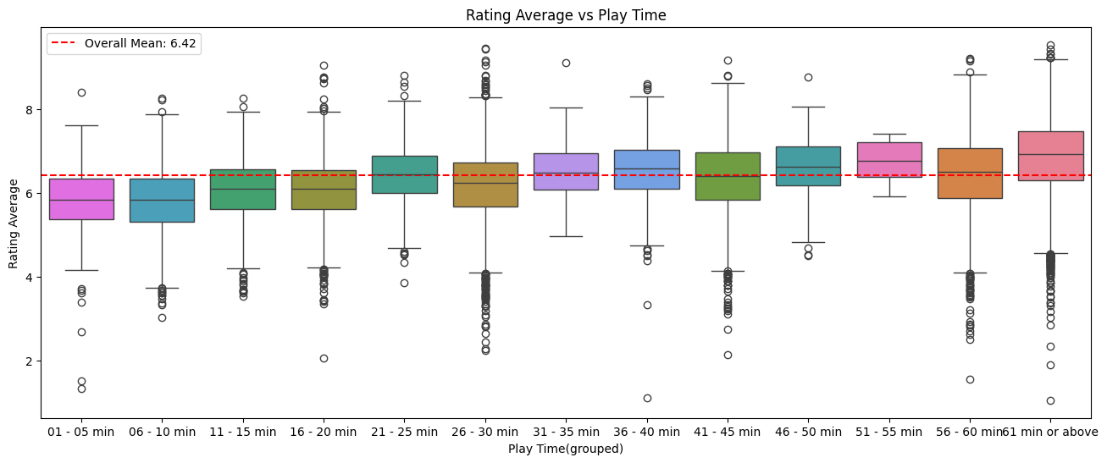
Rating Average vs Play Time

Slide 33
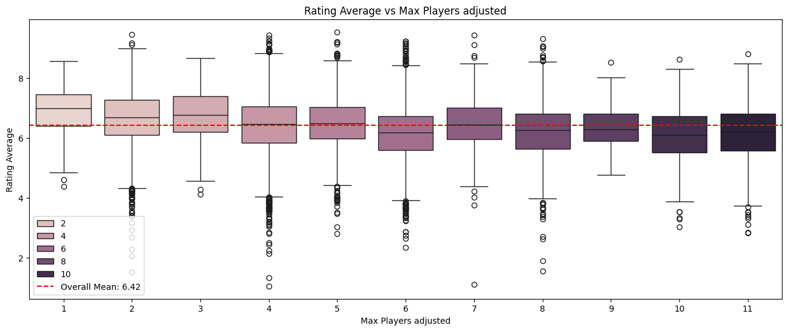
Rating Average vs Max Players adjusted

Slide 34
Multivariate Analysis

Slide 35
Multivariate Analysis
Independent Variables:
Min Players
Max Players adjusted
Play Time adjusted
Complexity Average
Dependent Variable:
Rating Average

Slide 36
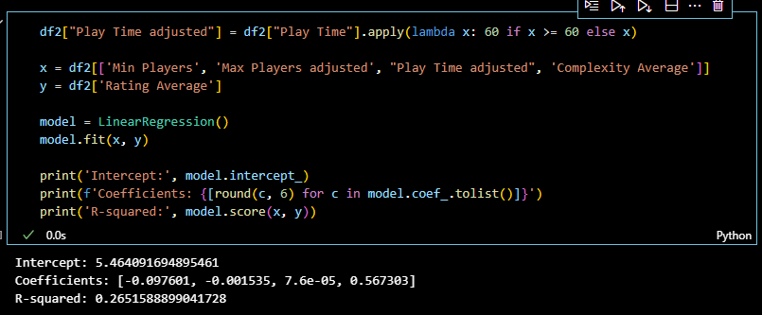
Code and result

Slide 37
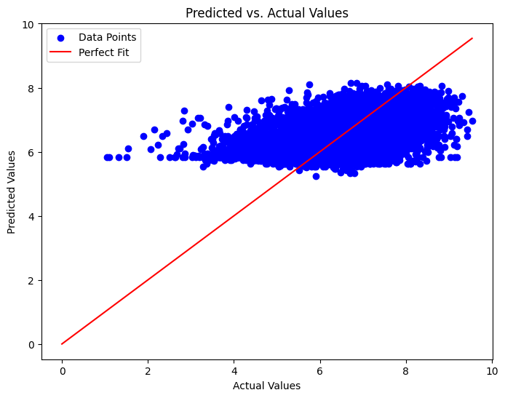
Predicted vs. Actual Values

Slide 38
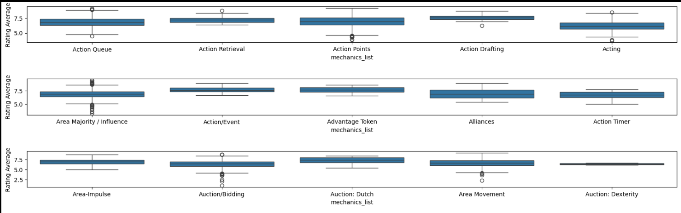
Bonus: Rating Average vs Mechanic

Slide 39
Challenges and Limitations

Slide 40
Challenges
Decide how to handle missing data / zero values
Decide how to present and analyze the data
code

Slide 41
Limitations
Data of “Owned Users” are inaccurate (better if provided by manufacturer)
Data are only from players who use BGG
Missing information
Only cover until 2022

Slide 42
Future Improvement
Collect data directly from manufacturers
Include data from different platform (different countries, languages)
Include more elements, e.g. average number of player

Slide 43
Future Work

Slide 44
Future Work
No future work
Too many limitations

Slide 45
Conclusion

Slide 46
Conclusion
Rating Average = 5.23 + 0.58 x Complexity Average
Rating average = 5.46 - 0.098 x Min Players - 0.0015 x Max Players + 0.000076 x Play Time (in min) + 0.57 x Complexity Average
But may not reflect the real situation
Pro players tend to use BGG and they love harder game...
High rating != Best Seller

Slide 47
Reference
https://www.kaggle.com/datasets/melissamonfared/board-games
https://www.fun.com/best-selling-board-games-all-time.html
https://boardgamegeek.com/

